Slide 1
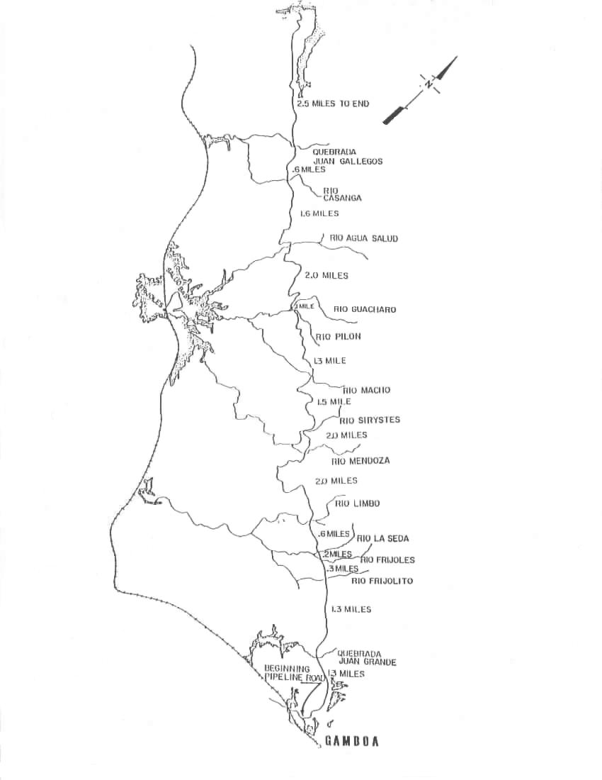
Figure 7 - Pipeline road map with distribution and abundance of study butterflies
Key
Anartia fatima
H. erato
H. sapho
H. cydno
17
16
15
14
13
183

